Slide 1
PRESENTATION ON TOWER OF HANOI
By:
Vijaykumar R Pai
Shreedhar Hegde

Slide 2
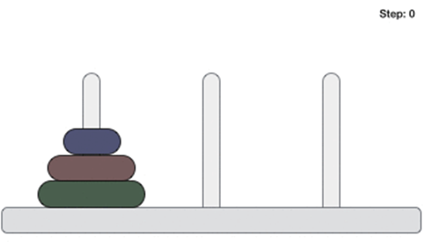
Definition and Concept
The Tower of Hanoi (also called the Tower of Brahma or Lucas' Tower) is a mathematical game or puzzle. It consists of three rods and a number of disks of different sizes, which can slide onto any rod. The puzzle starts with the disks in a neat stack in ascending order of size on one rod, the smallest at the top, thus making a conical shape.
The Tower of Hanoi puzzle was invented by the French mathematician Edouard Lucas in 1883.
The objective of the puzzle is to move the entire disks to another rod, obeying the following simple rules:
Only one disk can be moved at a time.
Each move consists of taking the upper disk from one of the rod and placing it on top of another rod.
No disk may be placed on top of a smaller disk.
With 3 disks, the puzzle can be solved in 7 moves. The minimal number of moves required to solve a Tower of Hanoi puzzle is 2^{n} − 1, where n is the number of disks.

Slide 3
Steps to move disk from one rod to an another :
Step 1 - Move n-1 disks from source to aux.
Step 2 - Move nth disk from source to dest
Step 3 - Move n-1 disks from aux to dest

Slide 4
Applications
The Tower of Hanoi is frequently used in psychological research on problem solving. There also exists a variant of this task called Tower of London for neuropsychological diagnosis and treatment of executive functions.
The Tower of Hanoi is also used as a Backup rotation scheme when performing computer data Backups where multiple tapes/media are involved.
The Tower of Hanoi is popular for teaching recursive algorithms to beginning programming students. A pictorial version of this puzzle is programmed into the emacs editor, accessed by typing M-x hanoi. There is also a sample algorithm written in Prolog.
The Tower of Hanoi is also used as a test by neuropsychologists trying to evaluate frontal lobe deficits.
In 2010, researchers published the results of an experiment that found that the ant species Argentine ant were successfully able to solve the 3-disk version of the Tower of Hanoi problem through non-linear dynamics and pheromone signals.

Slide 5
Pseudocode
START
Procedure Hanoi(disk, source, dest, aux)
IF disk == 1, THEN
move disk from source to dest
ELSE
Hanoi(disk - 1, source, aux, dest) // Step 1
move disk from source to dest // Step 2
Hanoi(disk - 1, aux, dest, source) // Step 3
END IF
END Procedure
STOP

Slide 6
Program
#include<stdio.h>
void Tower_Hanoi(int,char,char,char);
int main(void)
{
int n;
printf("Enter the number of disks:");
scanf("%d",&n);
Tower_Hanoi(n,'A','C','B');
return 0;
} /*end main*/

Slide 7
void Tower_Hanoi(int n, char frompeg, char topeg, char auxpeg)
{
/*If only one disk, make the move and return.*/
if(n==1)
{
printf("%s %c %s %c\n", "Move disk 1 from peg", frompeg, "to peg", topeg);
return;
} /*end if*/
/*Move top n-1 disks from A to B using C as auxiliary*/
Tower_Hanoi(n-1, frompeg, auxpeg, topeg);
/*Move remaining disk from A to C*/
printf("%s %d %s %c %s %c\n", "Move disk", n, "from peg", frompeg, "to peg", topeg);
/*Move n-1 disk from B to C using A as auxiliary*/
Tower_Hanoi(n-1, auxpeg, topeg, frompeg);
}
/*end Tower_Hanoi*/

Slide 8
Output
Enter the number of disks:3
Move disk 1 from peg A to peg C
Move disk 2 from peg A to peg B
Move disk 1 from peg C to peg B
Move disk 3 from peg A to peg C
Move disk 1 from peg B to peg A
Move disk 2 from peg B to peg C
Move disk 1 from peg A to peg C

Slide 9
Viva Questions
Which data structure can be used suitably to solve the Tower of Hanoi problem?
a) Tree b) Heap c) Priority queue d) Stack
Answer: d
2. What is the number of moves required in the Tower of Hanoi problem for k disks?
a) 2k – 1 b) 2k + 1 c) 2^{k} + 1
d) 2^{k} – 1
Answer: d

Slide 10
THANK YOU

